Slide 1
Comparison of values of ASTER spectral band Ratios with measured copper concentration of Zara rock chips ASTER spectral band Ratios using
R ( Tree-Based method)
Benhur Tedros

Slide 2
INTRODUCTION
ASTER spectral band ratios can be produced by dividing two bands at a time.
  ASTER data has 14 bands from which 46 nonreciprocal ratios can be produced.
  Ratio codes techniques were developed by Perry and Vincent(2009) from laboratory spectra of 145 minerals to enable mapping of mineral/rocks from satellite.
    It works by displaying a target mineral with a higher ratio code (8 or 9) to one of the three layers (blue or green or red), while assigning the other two with low ratio code(0 or 1) to display the target mineral as the layer with higher ratio code.

Slide 3
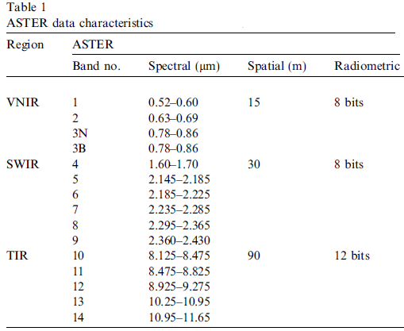
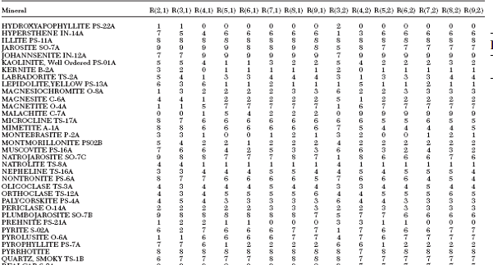
Malachite, CuCo3(OH)

Slide 4
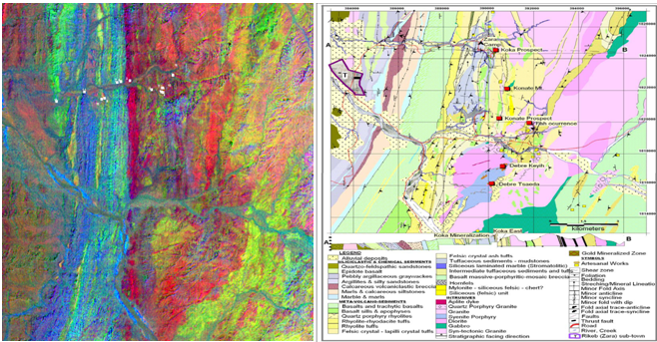
I) ASTER ratio image of R (2, 1), R (6, 7) and R (3, 4) in RGB mapped granites as shiny red to pink. II) Geologic Map of study area

Slide 5
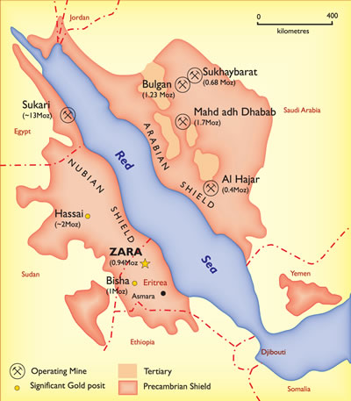
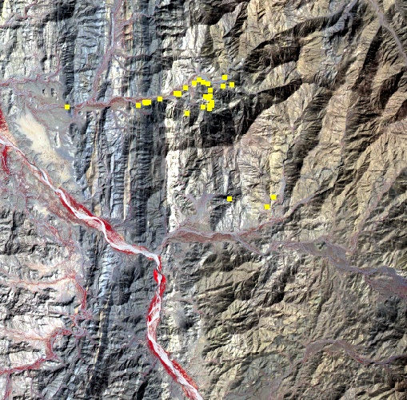
STUDY AREA
Major regional gold deposits
ASTER image of single band combination of 1, 2, 3 displayed as blue, green and red respectively

Slide 6
R- APPLICATIONS
R is a comprehensive statistical and graphical programming language
    Useful in the discovery and exploration of complex multivariate relationships among variables
R contains varieties of statistical components used for different types of data analysis such as predictive models, latent variable models, partitioning methods
    Partitioning method contains a Tree-Based method, which include classification and regression trees, random forests, and other partitioning methodologies

Slide 7
DATA COLLECTED
Measured copper content for 31 rock chips collected from the study area
ASTER data collected in January 21, 2007
  10 characteristic ASTER band ratios( dark-object subtracted and haze adjusted) are used
R software Package and ERMapper 7

Slide 8
Table-1 Copper concentration of the collected rock chips with their respective ASTER band ratios’ value
Sample No | Cu(ppm) | ASTER band ratios
 |  | 13,10 | 4,6 | 6,8 | 4,8 | 7,6 | 6,4 | 9,1 | 6,2 | 8,5 | 4,9 | 9,5 | 8,3 | 5,4 | 5,7
1 | 5 | 1.361 | 1.375 | 0.947 | 0.74 | 1.05 | 0.73 | 0.49 | 0.56 | 0.79 | 1.78 | 0.79 | 0.9 | 0.72 | 0.94
2 | 4 | 1.363 | 1.127 | 1.078 | 0.89 | 0.96 | 0.89 | 0.57 | 0.76 | 0.79 | 1.54 | 0.79 | 0.81 | 0.83 | 0.96
3 | 30 | 1.381 | 1.172 | 1.074 | 0.86 | 1.03 | 0.86 | 0.65 | 0.86 | 0.8 | 1.46 | 0.8 | 0.9 | 0.82 | 0.97
4 | 4 | 1.377 | 1.100 | 1.053 | 0.91 | 0.98 | 0.91 | 0.56 | 0.73 | 0.83 | 1.5 | 0.83 | 1.05 | 0.8 | 0.9
5 | 5 | 1.359 | 1.172 | 0.983 | 0.89 | 0.98 | 0.86 | 0.51 | 0.68 | 0.74 | 1.64 | 0.74 | 1.03 | 0.83 | 0.98
6 | 4 | 1.386 | 1.240 | 1.000 | 0.81 | 1.02 | 0.81 | 0.41 | 0.57 | 0.78 | 1.66 | 0.78 | 0.86 | 0.78 | 0.94
7 | 230 | 1.369 | 1.091 | 1.073 | 0.92 | 0.98 | 0.92 | 0.54 | 0.76 | 0.76 | 1.58 | 0.76 | 1.08 | 0.84 | 1
8 | 20 | 1.327 | 1.140 | 1.000 | 0.88 | 0.98 | 0.88 | 0.61 | 0.74 | 0.87 | 1.45 | 0.87 | 1.18 | 0.79 | 0.92
9 | 11 | 1.377 | 1.277 | 0.940 | 0.79 | 1.02 | 0.79 | 0.42 | 0.48 | 0.85 | 1.52 | 0.85 | 0.85 | 0.77 | 0.96
10 | 276 | 1.376 | 1.191 | 1.000 | 0.84 | 1 | 0.84 | 0.53 | 0.66 | 0.82 | 1.42 | 0.82 | 1.03 | 0.83 | 0.95
11 | 89 | 1.400 | 1.000 | 1.056 | 1 | 0.92 | 1 | 0.58 | 0.72 | 0.79 | 1.3 | 0.79 | 1.08 | 0.97 | 1.05
12 | 7 | 1.390 | 1.176 | 0.962 | 0.85 | 1.02 | 0.85 | 0.52 | 0.63 | 0.88 | 1.45 | 0.88 | 0.94 | 0.79 | 0.89
13 | 4 | 1.390 | 1.153 | 1.000 | 0.87 | 1 | 0.87 | 0.44 | 0.53 | 0.89 | 1.41 | 0.89 | 0.79 | 0.8 | 0.92
14 | 32 | 1.385 | 1.182 | 0.965 | 0.85 | 0.98 | 0.85 | 0.43 | 0.52 | 0.81 | 1.57 | 0.8 | 0.85 | 0.79 | 0.95
15 | 4 | 1.398 | 1.070 | 1.075 | 0.94 | 0.95 | 0.94 | 0.54 | 0.67 | 0.85 | 1.42 | 0.85 | 1 | 0.83 | 0.93
16 | 4 | 1.363 | 1.098 | 1.000 | 0.91 | 1 | 0.91 | 0.54 | 0.7 | 0.78 | 1.44 | 0.78 | 1.05 | 0.89 | 0.98
17 | 7 | 1.373 | 1.162 | 1.014 | 0.86 | 0.96 | 0.86 | 0.52 | 0.67 | 0.8 | 1.56 | 0.79 | 1.03 | 0.77 | 0.93
18 | 132 | 1.379 | 1.083 | 1.379 | 0.92 | 0.98 | 0.88 | 0.43 | 0.61 | 0.75 | 1.58 | 0.78 | 1.12 | 0.84 | 0.98
19 | 9 | 1.379 | 1.118 | 1.063 | 0.9 | 0.96 | 0.9 | 0.42 | 0.64 | 0.81 | 1.53 | 0.81 | 0.84 | 0.81 | 0.94
20 | 158 | 1.381 | 1.096 | 1.083 | 0.91 | 0.98 | 0.91 | 0.61 | 0.68 | 0.83 | 1.49 | 0.83 | 1.14 | 0.81 | 0.9
21 | 142 | 1.376 | 1.129 | 0.969 | 0.89 | 1 | 0.89 | 0.43 | 0.62 | 0.78 | 1.54 | 0.78 | 0.94 | 0.83 | 0.94
22 | 74 | 1.388 | 1.140 | 1.018 | 0.88 | 1.02 | 0.88 | 0.49 | 0.65 | 0.78 | 1.53 | 0.78 | 0.95 | 0.83 | 0.93
23 | 24 | 1.388 | 1.178 | 1.023 | 0.85 | 1 | 0.85 | 0.39 | 0.52 | 0.77 | 1.53 | 0.77 | 0.8 | 0.82 | 0.96
24 | 13 | 1.388 | 1.143 | 1.000 | 0.88 | 1.04 | 0.88 | 0.34 | 0.42 | 0.83 | 1.59 | 0.83 | 0.68 | 0.82 | 0.9
25 | 69 | 1.367 | 1.056 | 1.059 | 0.95 | 1.05 | 0.95 | 0.64 | 1.12 | 0.68 | 1.48 | 0.68 | 1.67 | 0.87 | 0.87
26 | 5 | 1.374 | 1.138 | 1.036 | 0.88 | 0.97 | 0.88 | 0.47 | 0.73 | 0.68 | 1.7 | 0.69 | 1.16 | 0.85 | 1
27 | 12 | 1.362 | 1.051 | 1.141 | 0.95 | 0.9 | 0.95 | 0.39 | 0.6 | 0.85 | 1.45 | 0.85 | 0.78 | 0.81 | 0.94
28 | 79 | 1.375 | 1.114 | 1.048 | 0.9 | 0.96 | 0.9 | 0.42 | 0.74 | 0.79 | 1.61 | 0.79 | 1 | 0.78 | 0.91
29 | 176 | 1.382 | 1.152 | 1.070 | 0.87 | 0.98 | 0.87 | 0.35 | 0.53 | 0.76 | 1.69 | 0.76 | 0.73 | 0.78 | 0.91
30 | 60 | 1.377 | 1.065 | 1.045 | 0.94 | 0.96 | 0.94 | 0.34 | 0.52 | 0.8 | 1.56 | 0.79 | 0.82 | 0.8 | 0.89
31 | 4 | 1.345 | 1.064 | 1.068 | 0.94 | 0.94 | 0.94 | 0.33 | 0.53 | 0.73 | 1.54 | 0.73 | 0.75 | 0.88 | 1

Slide 9
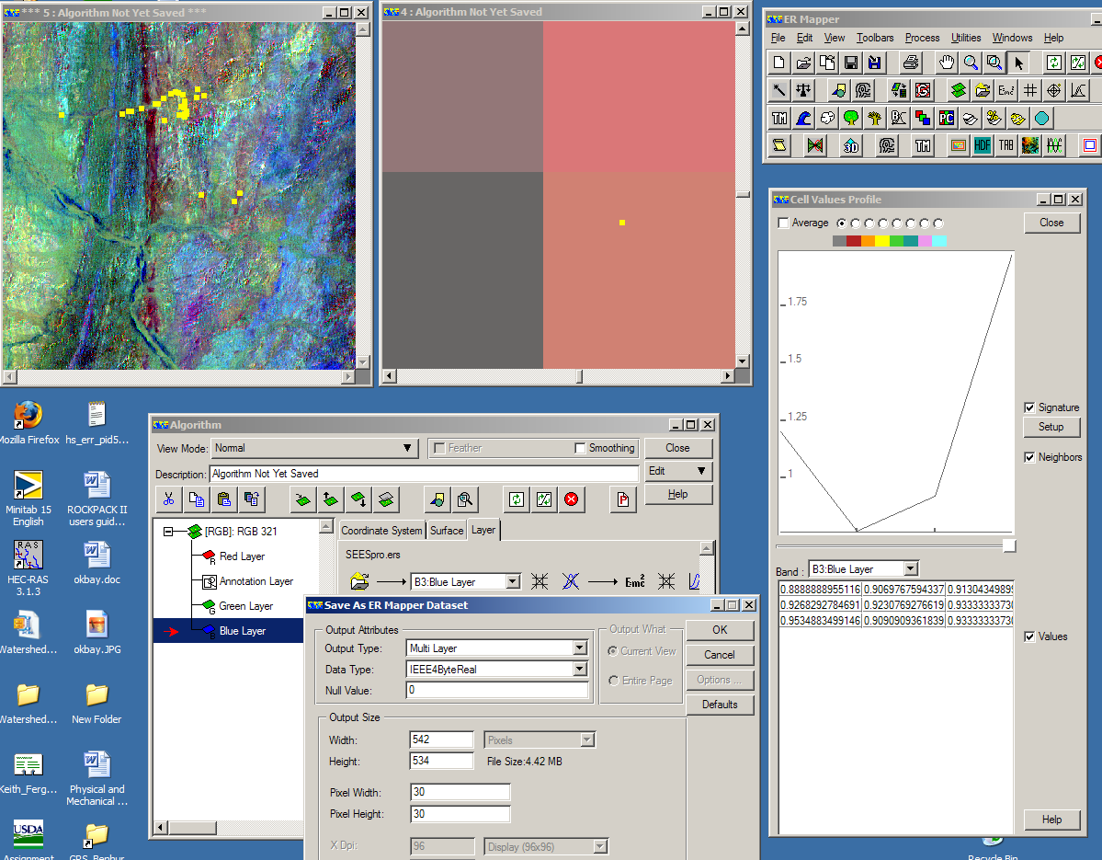
Extracting the band ratio values of each rock chips using ERMapper

Slide 10
Explanatory Data Analysis (EDA)
Tree- Based Model is used
  Recursive partitioning--- for data mining
    Explore the structure of a set of data
    Develop easy to visualize decision rules for predicting a categorical( classification tree) or continuous( regression tree) outcome

Slide 11
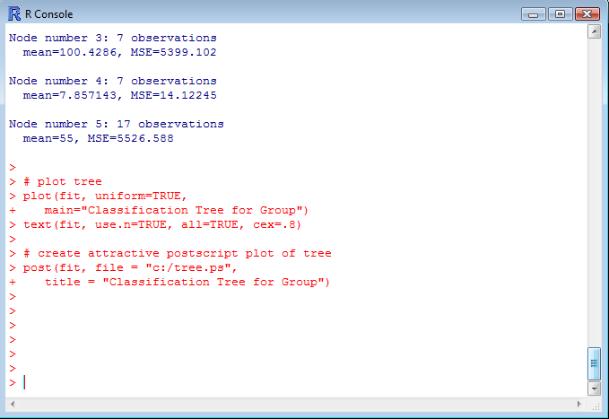
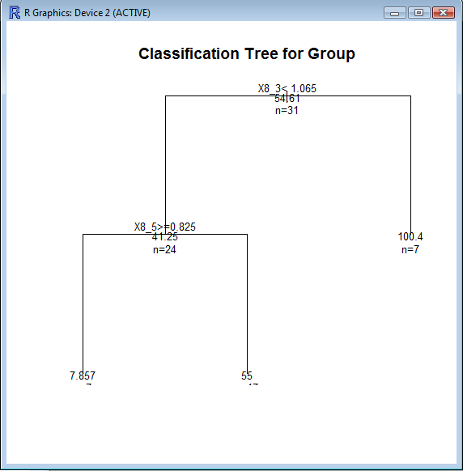
RESULTS

Slide 12
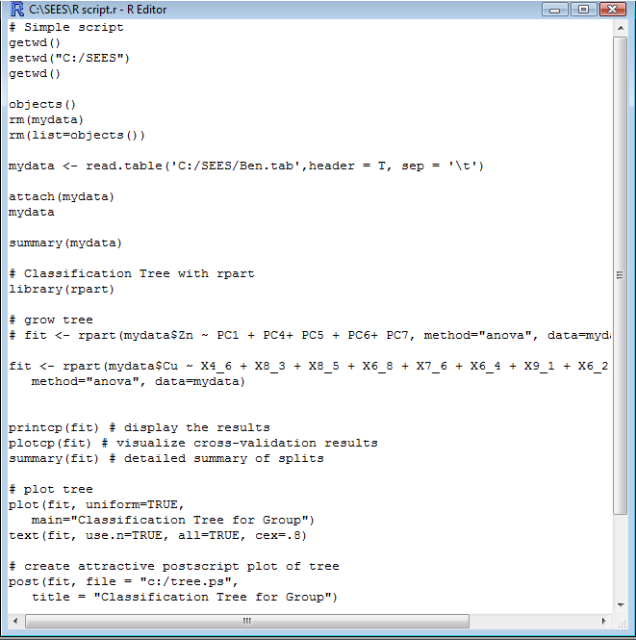
The R Script used

Slide 13
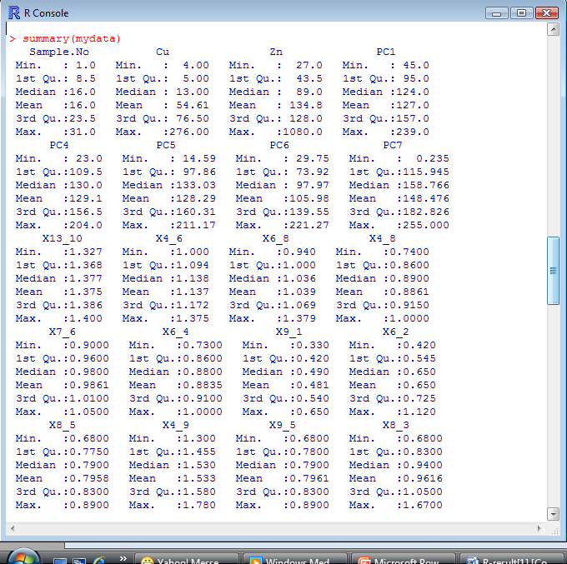
Summary Data

Slide 14
Validating the results
  Exposure of malachite mineral, copper carbonate, in the study area is mapped using ASTER Band ratios with ratios code from Perry and Vincent(2009)
    R(1,2), R(3,1) and R(2,4) displayed as blue, green and red respectively.[ratios was not used in the data mining]
  Malachite has 9, 0 and 0 ratio code for the above ratio combination, which display malachite as blue in the image
  From the classification tree, the higher and lower concentration of copper is also mapped within the study area

Slide 15
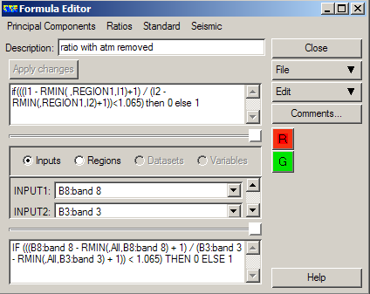
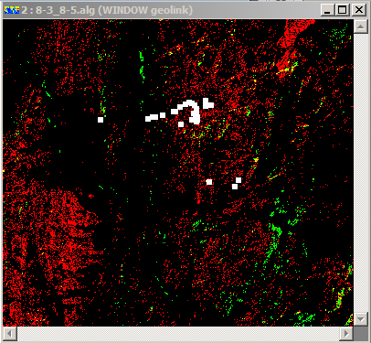
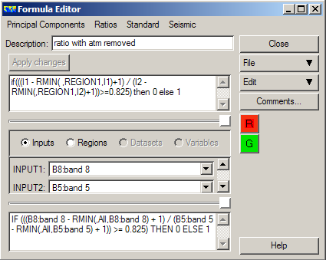
Higher concentration of Cu displayed as red from the first tree, and green from the second(

Slide 16
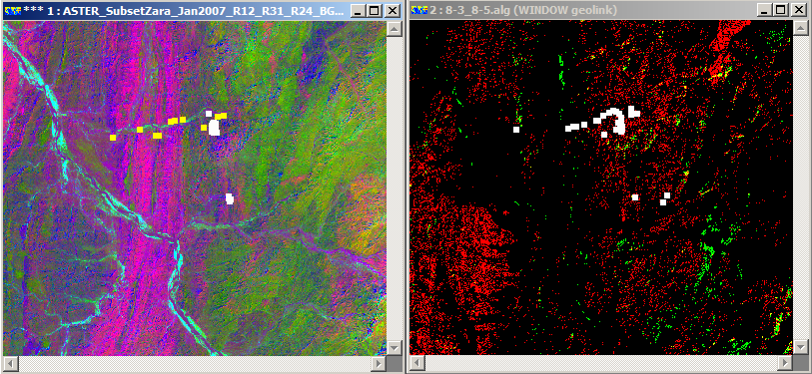
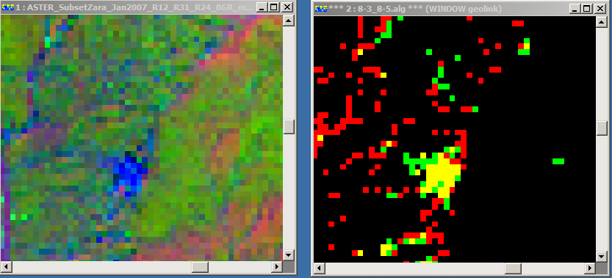
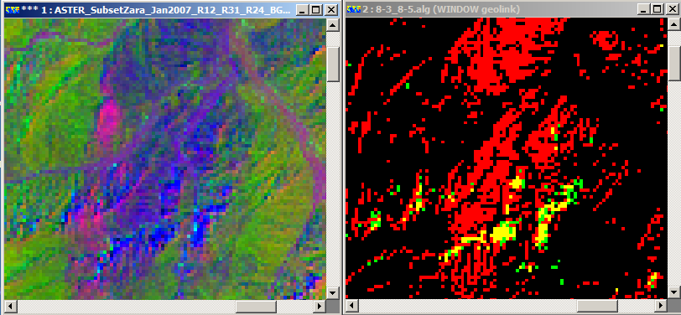
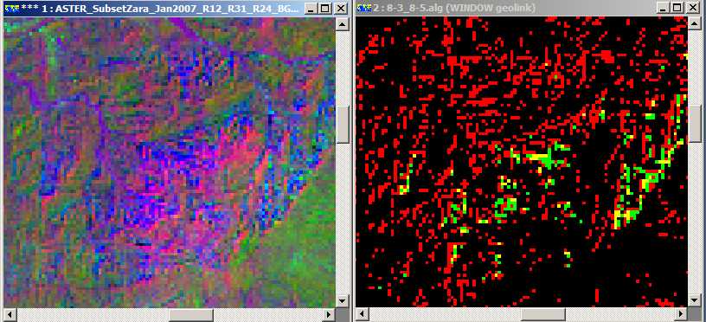
ASTER band ratio image of R(1,2), R(3,1) and R(2,4)
2. Mapped concentration of Cu depending on the results of classification tree

Slide 17
Questions?

